Slide 1
What do you like the best in you?
Is it your nose, or eyes or face or your height or your hair?
Today we are going to know about a tree who was sad about it needle like leaves because no birds ever made their nest on it.

Slide 2


Slide 3
One day Shetty the magician was returning home. Suddenly it began to rain. It rained heavily. He saw a fir tree. He took shelter under the Fir tree. Shetty was happy that he did not get wet. He thanked the tree. He wanted to reward the tree. He granted the tree four wishes.

Slide 4
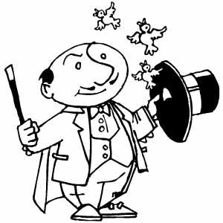

The magician
The magic wand

Slide 5
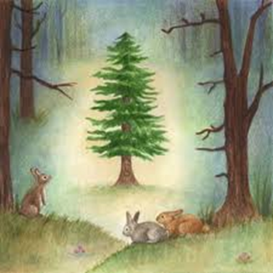
The little Fir tree

Slide 6
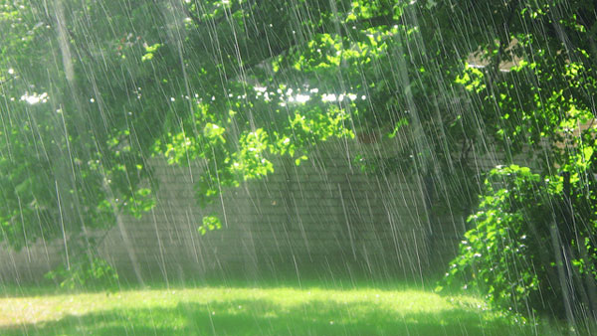
Suddenly it began to rain

Slide 7

He ran towards the Fir tree and he did not get wet.

Slide 8


Shetty was happy. He rewarded the tree with four wishes.

Slide 9
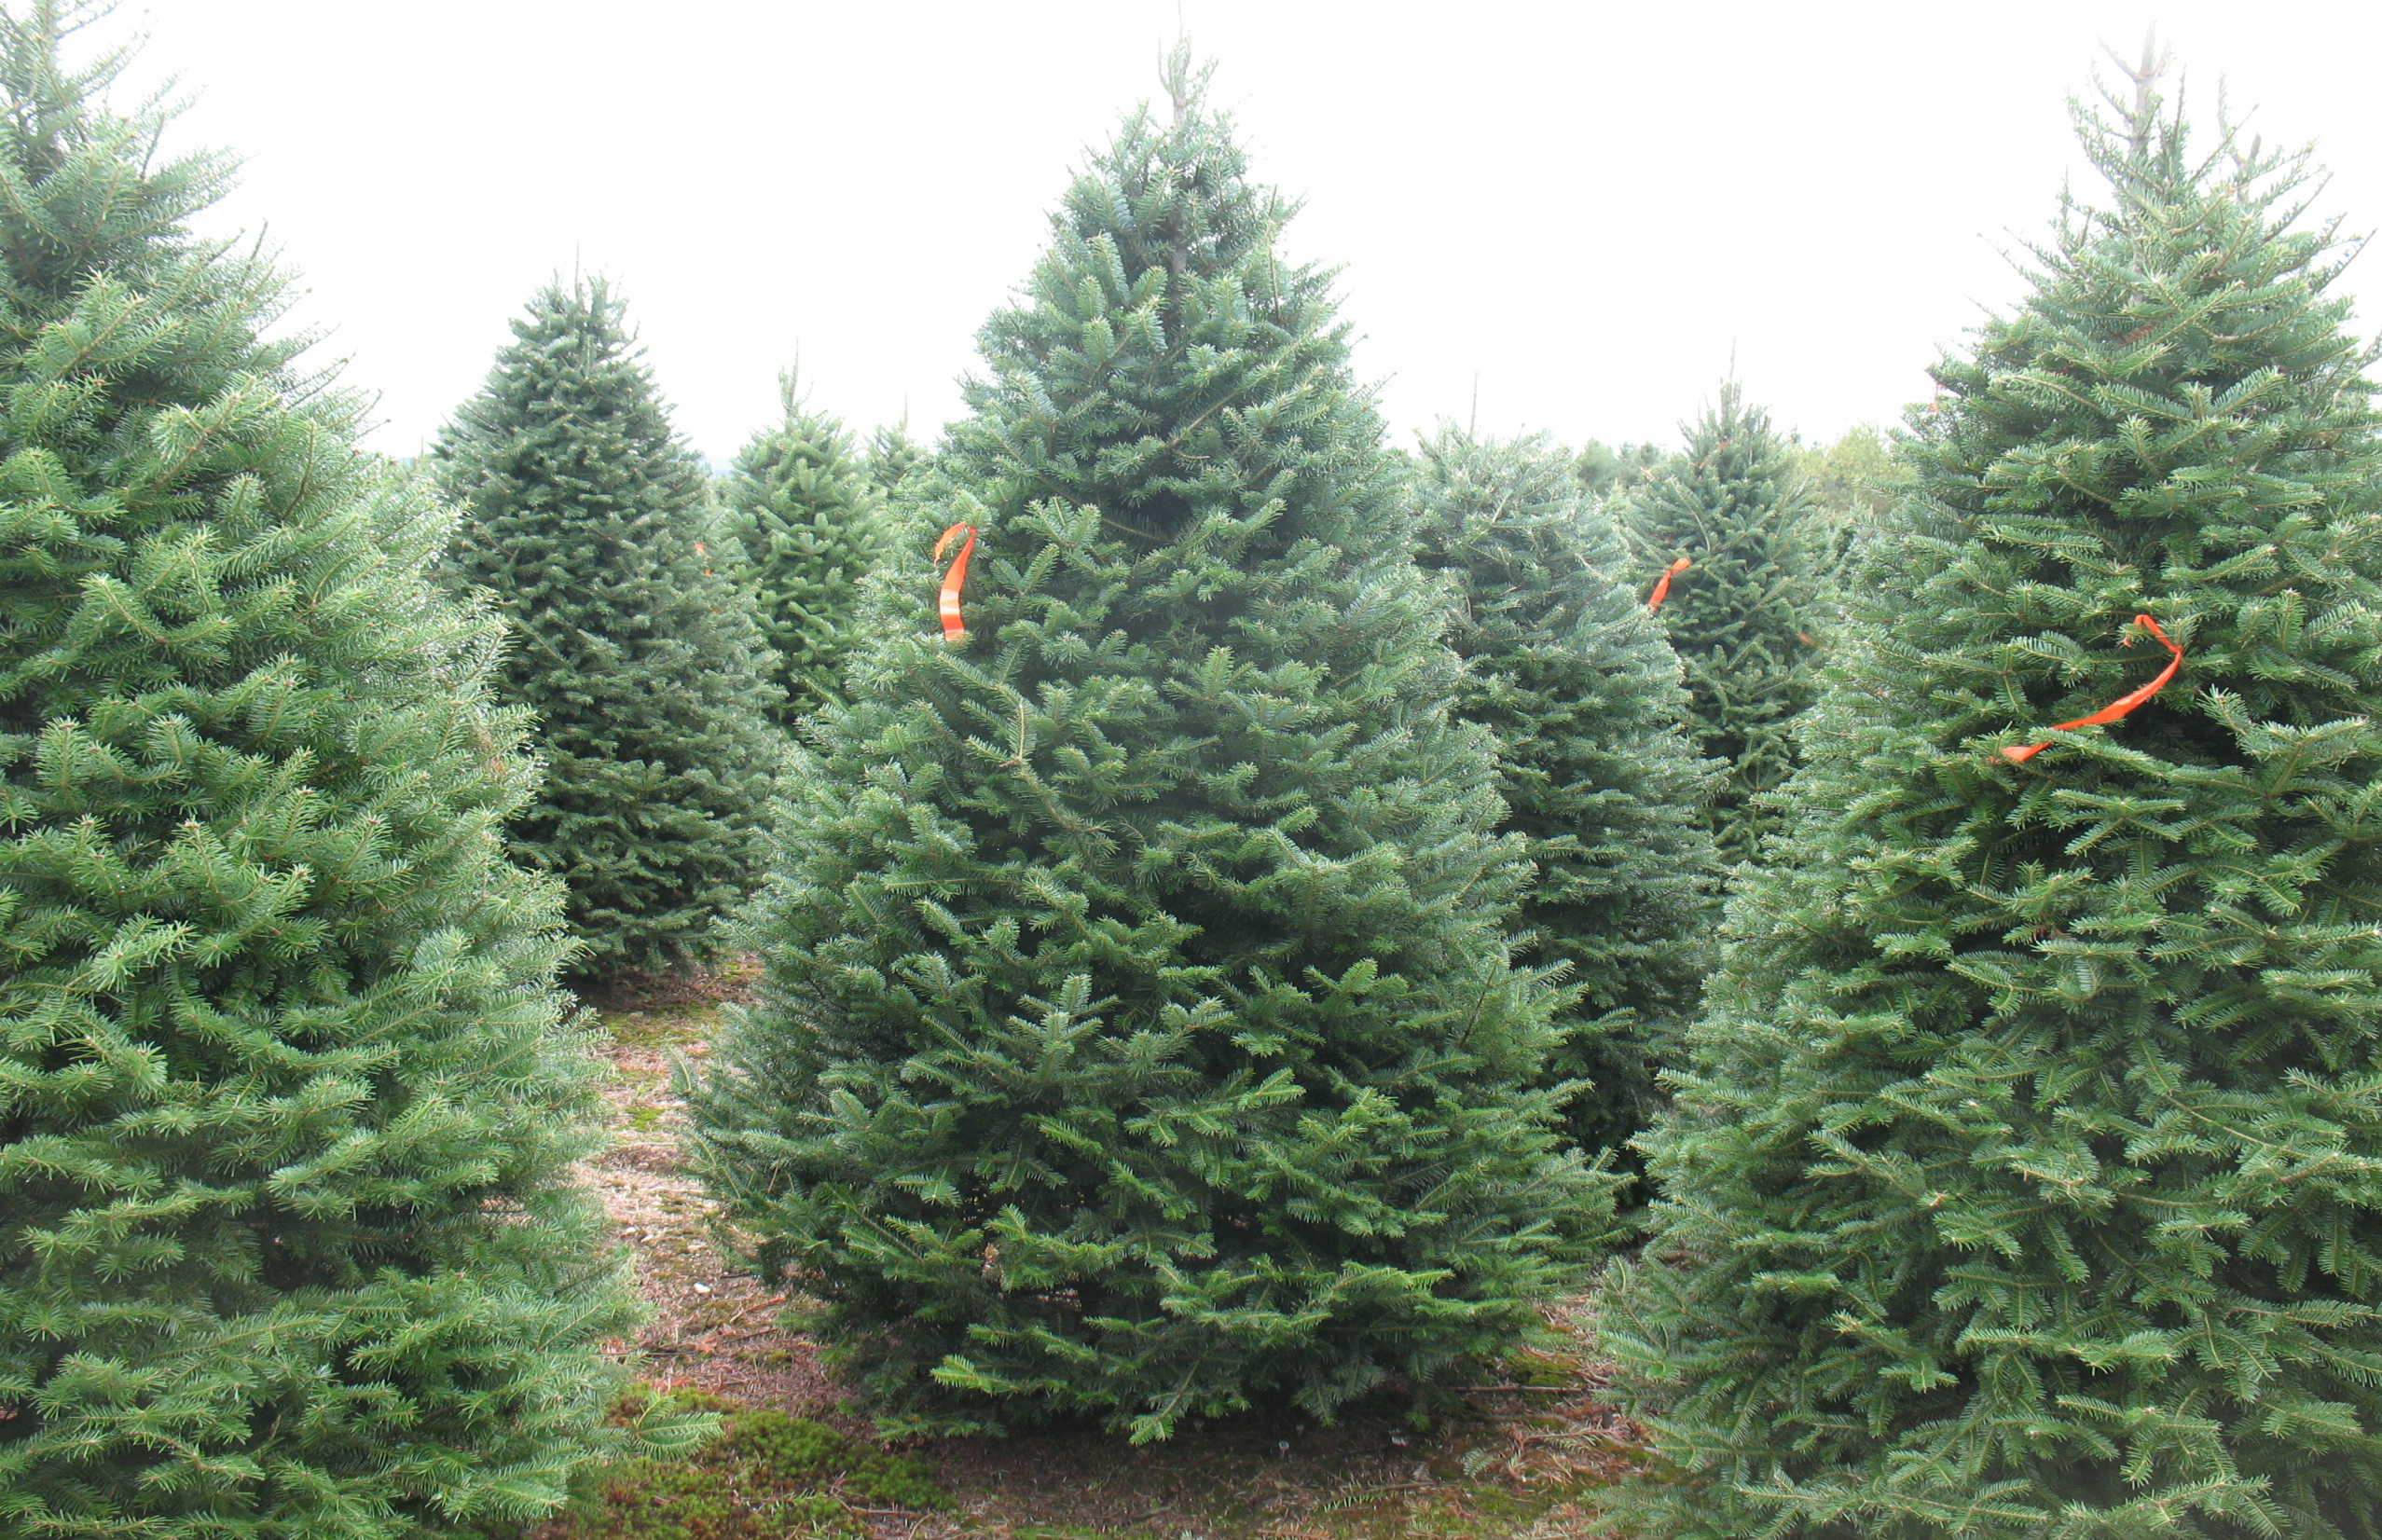
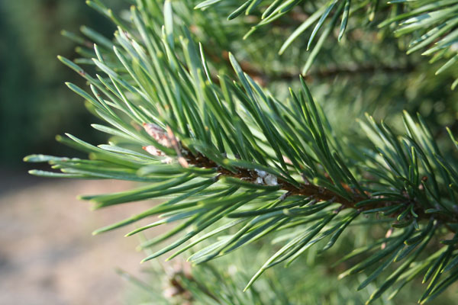
A fir tree has needle like leaves.

Slide 10
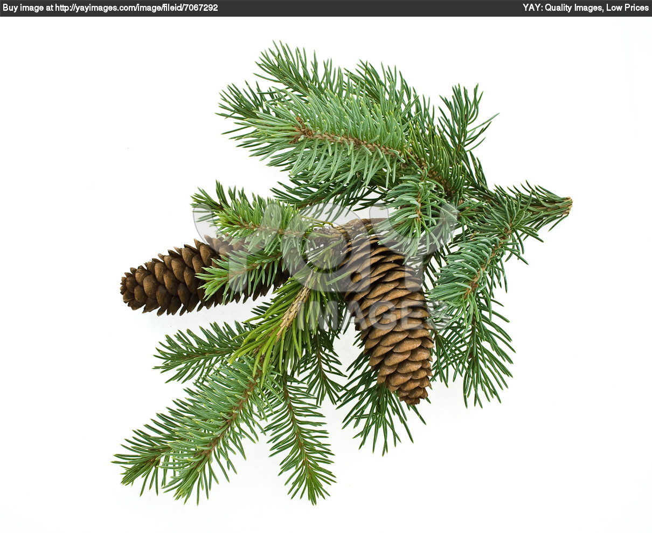
A Fir tree branch with its fruit

Slide 11
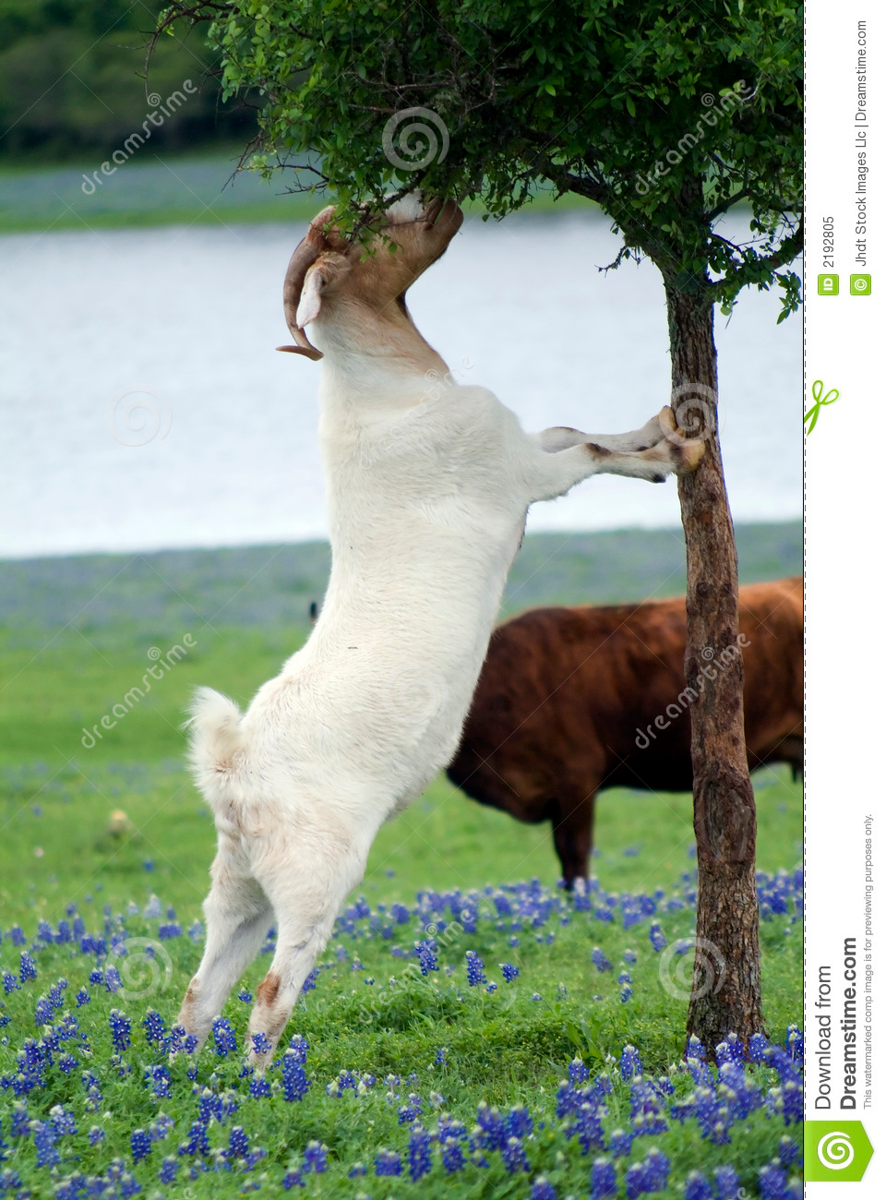
“I wish I had green leaves like my other friends.” Next morning its wish was granted. Soon a goat came along and ate all its leaves.

Slide 12
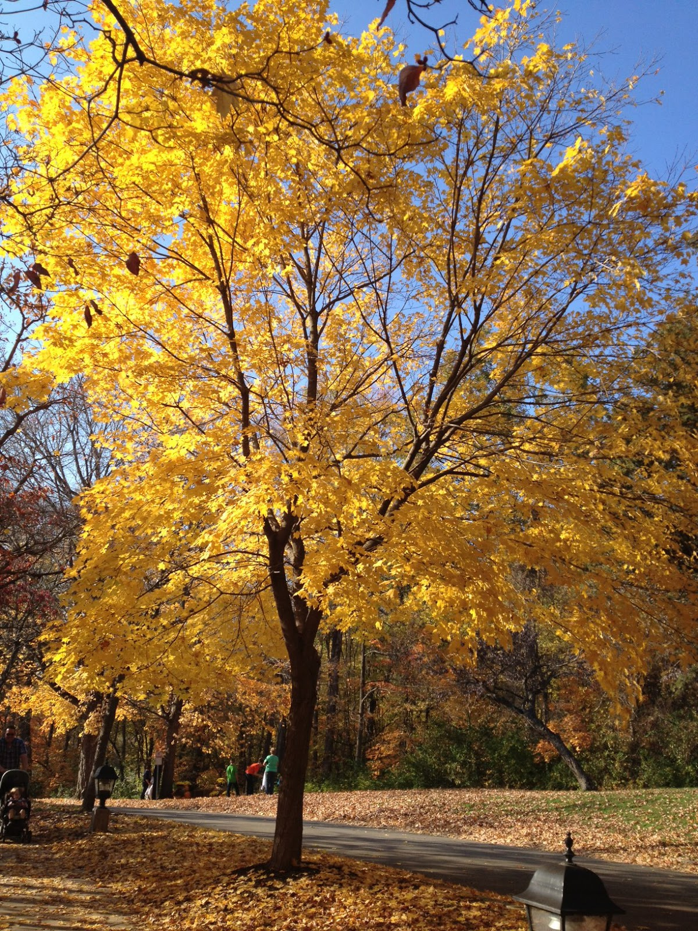

“Oh! Dear, I wish I had gold leaves. “ Next morning it had gold leaves. A man came along stole the leaves.

Slide 13
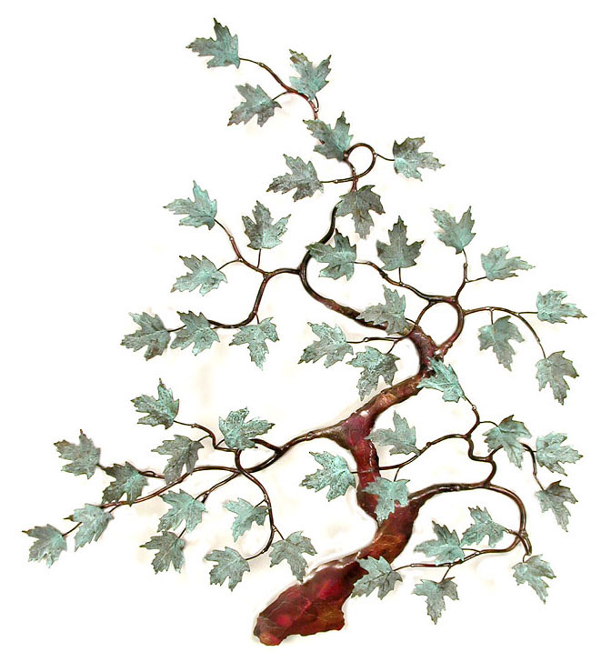
Then the Fir tree wished to have glass leaves. The next day its leaves shone in the bright sun.

Slide 14
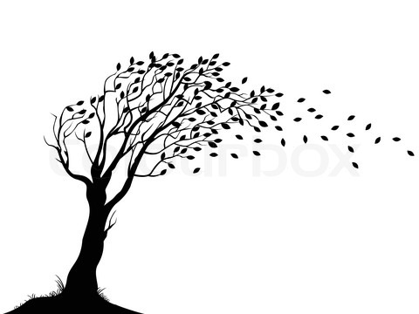
At night the wind blew whoo---- oo---oo---.

Slide 15
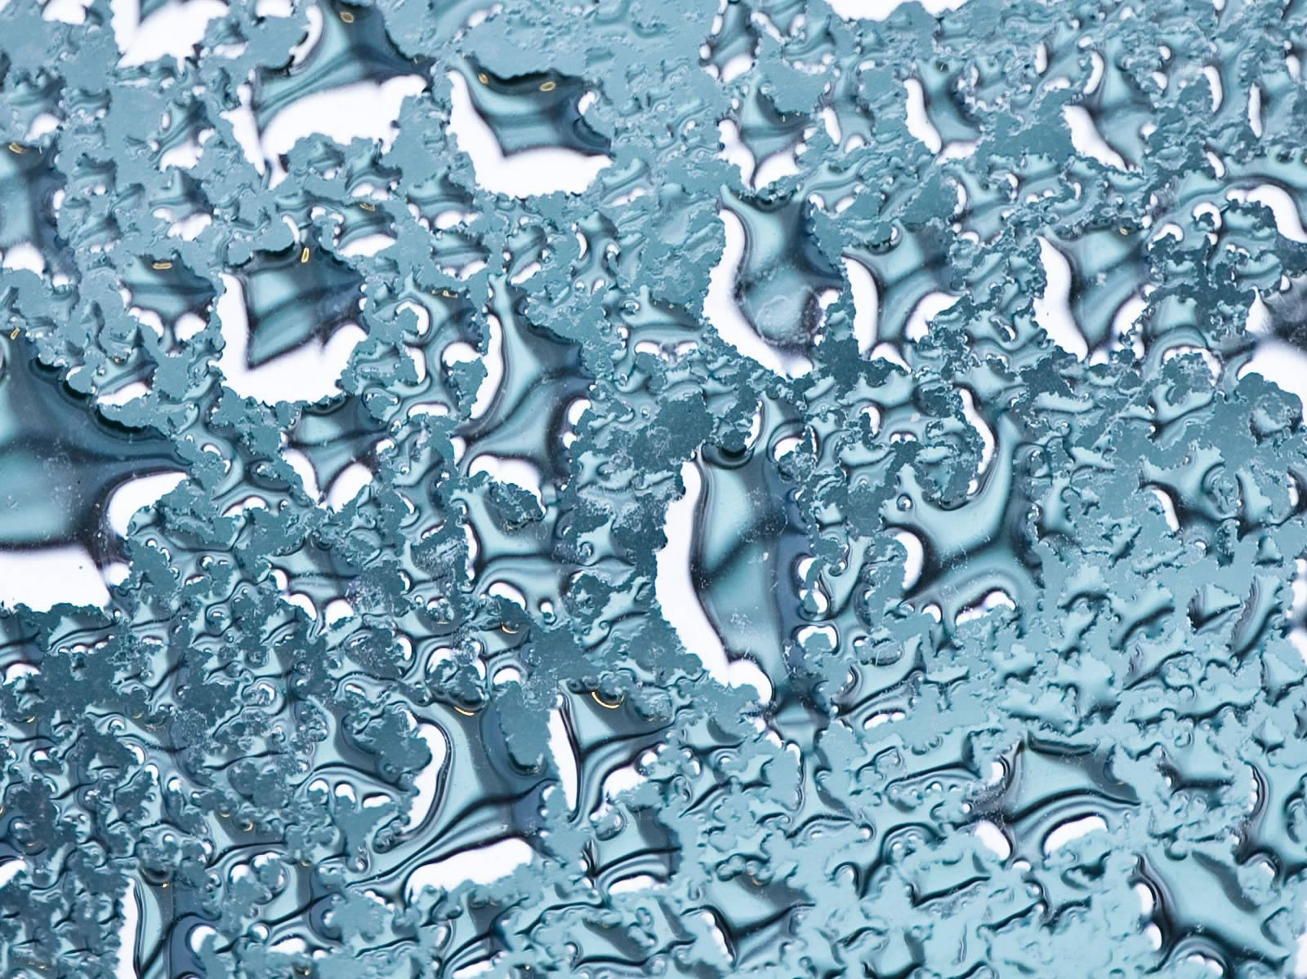
All the glass leaves broke.

Slide 16

“Oh! Dear, said the fir tree. I like my old needle like leaves.” The next morning it had all its needles back again.

Slide 17
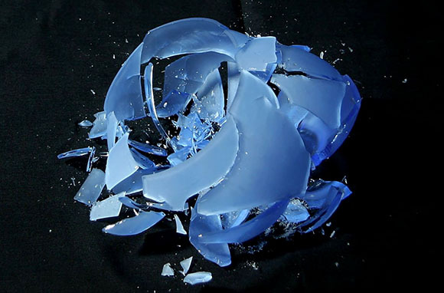
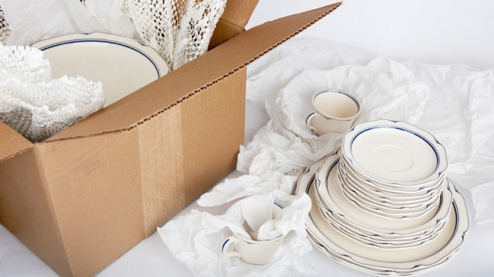
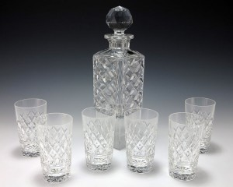
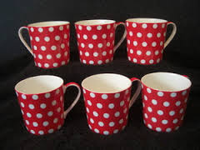
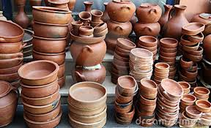
Things which break easily.

Slide 18
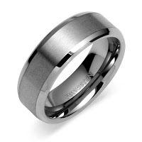
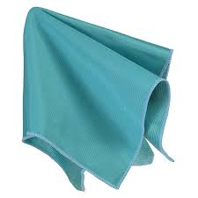

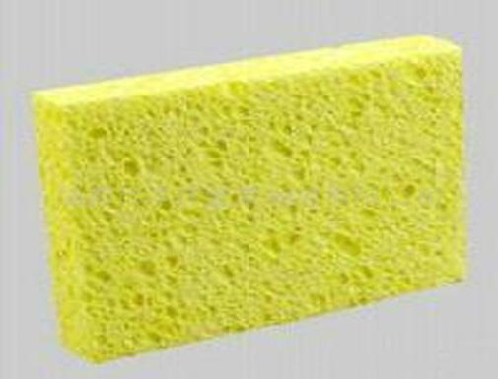
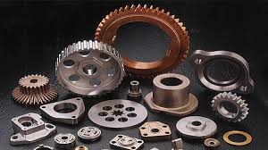
Things that do not break.

